Slide 1
MSc Project
(CMP060L050H)
Viva Presentation
Credit Card Fraud Detection Using Machine Learning
Student Name:
Date:
Supervisor:
Second Marker:

Slide 2
Outline
Context​
Problematic statement​
Objectives ​
Methodology​
Project management​
Literature review​
Your contributions
Conclusion

Slide 3
Context
Rapid growth of online and contactless card payments.
Large transaction volumes require automated monitoring.
Fraud behaviour changes across time and digital channels [1].
Machine learning can learn patterns from historical transactions [1].
Notes:
Digital banking, e-commerce and contactless payments have increased the number and speed of financial transactions. This growth has also increased opportunities for credit card fraud. Manual monitoring is not suitable for very large transaction datasets, while fixed rules may become less effective when fraud behaviour changes. Machine learning offers a data-driven method for identifying unusual and hidden transaction patterns. The current project therefore investigates how supervised machine-learning algorithms can support reliable fraud detection using an anonymised credit card transaction dataset.

Slide 4
Problem Statement - WHY
Problem: Lack of reliable detection for rare and changing fraud patterns [2].
Affected: banks, payment providers, merchants and cardholders.
Where/when: online, contactless and other real-time card transactions.
Manual investigation is time-consuming and creates high cost.
However, high accuracy can still hide missed fraudulent transactions [2].
Importance: earlier detection can reduce loss, disruption and customer harm.
Notes:
The project tackles the challenge of detecting rarely occurring and evolving credit card fraud patterns. The issue arises when banks and payment service providers perform real-time processing of high volume types of card transactions, like online or contactless payments. It impacts financial institutions, merchants, and cardholders, as it can lead to financial losses if fraud goes undetected and disrupt legitimate transactions if it is a false alarm. Also, the Manual investigation is very slow and costly. But with severe class imbalance, it can have a low model which correctly predicts high accuracy and fail to predict fraud. This problem is significant to reduce the loss, investigation cost, and customer's inconvenience.

Slide 5
Objective - WHAT
To understand and clean the credit card transaction dataset.
To explore fraud patterns through data visualization.
To select relevant predictive variables.
To prepare an imbalanced dataset for modeling.
To train five supervised machine-learning algorithms.
To compare performance using multiple evaluation measures.
To identify the most suitable model for this dataset.
Notes:
The project aims to develop and compare supervised machine-learning models for credit card fraud detection. These objectives provide a clear route from raw transaction data to an evidence-based recommendation, without claiming model performance before the experimental stage has been completed.

Slide 6
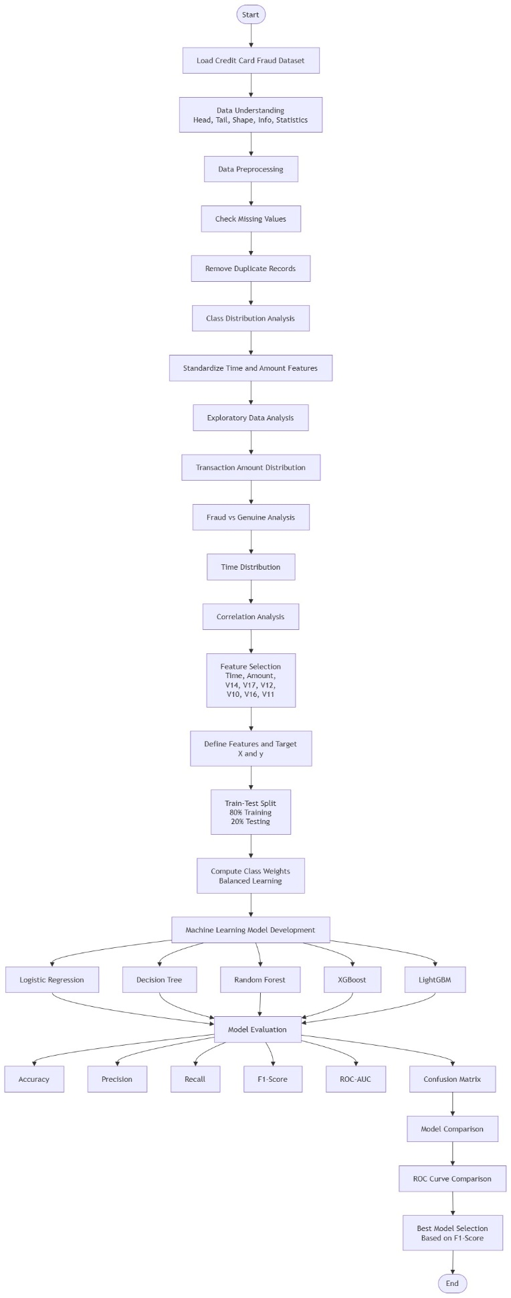
Methodology - HOW
Data Collection & Preprocessing – Use the Kaggle credit card transaction dataset, handle missing values, remove duplicates, scale features, and apply SMOTE to balance fraud and non-fraud classes.
Model Development – Train and compare Logistic Regression, Decision Tree, Random Forest, Support Vector Machine (SVM), and XGBoost models.
Implementation Tools – Develop the system using Python in Jupyter Notebook with Pandas, NumPy, Scikit-learn, Matplotlib, Seaborn, and Imbalanced-learn.
Model Evaluation – Assess performance using Accuracy, Precision, Recall, F1-score, ROC-AUC, and Confusion Matrix.
Results & Findings – Compare all models and identify the most accurate and reliable algorithm for credit card fraud detection.
Notes:
The objectives will be met by a quantitative experimental design with a secondary anonymised dataset. Python and Jupyter are chosen to ensure a reproducible environment, Pandas and NumPy for efficient data handling, and Matplotlib and Seaborn for visual analysis of data. Completed Phase includes Quality Check and Exploration. The next step will be to scale appropriate variables, choose predictors and then split the data in a stratified 80:20 to ensure that the rare fraud class remains. Five algorithms are chosen for comparison, i.e., four interpretable, tree-based and one boosting. This is better than using a single algorithm as it allows a better comparison since it is done under the same conditions.

Slide 7
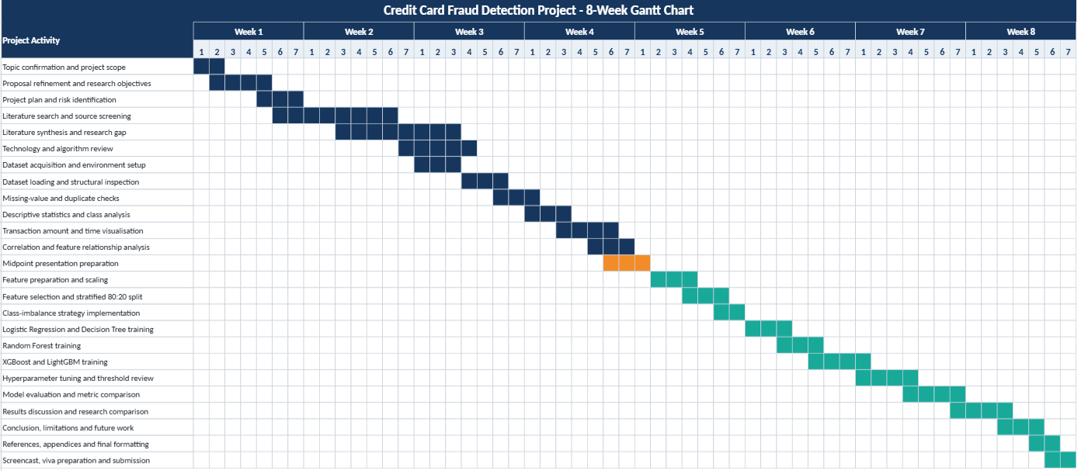
Project Management
Completed
  Proposal development
  Literature review
  Dataset selection
  Research methodology
  Data cleaning and visualisation
Current
  Data preprocessing
  Model implementation preparation
Remaining
  Model training and evaluation
  Results analysis
  Dissertation writing and final submission
Notes:
The completed work includes proposal development, the literature review, dataset selection, research methodology, data-quality checks and exploratory visualisation. This is about half of the proposed project. Now it is the preprocessing and preparation of data for the model implementation. Training the model is still pending. The following works will be carried out model training, tuning, model evaluation, comparative results analysis, discussion and completion of the final report. These activities are represented in the Gantt chart below for the span of 8 weeks.

Slide 8
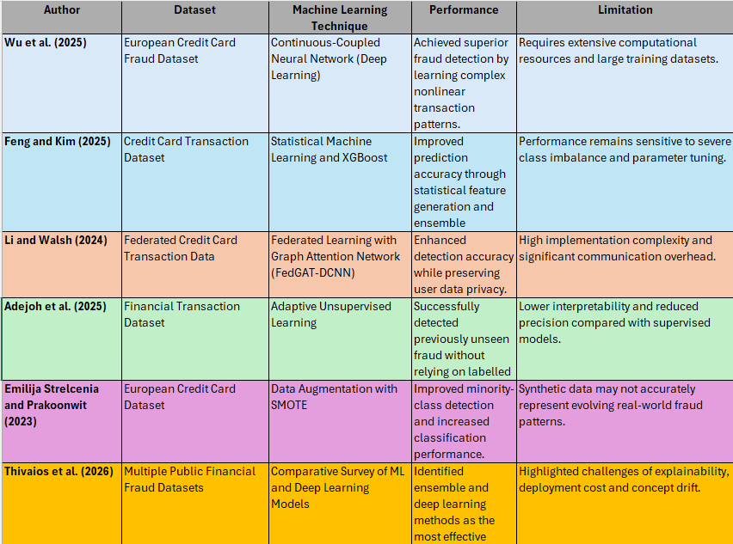
Literature Review
Notes:
Speaker note- This chapter reviews existing research on credit card fraud detection using machine learning. It highlights key challenges including class imbalance, evolving fraud patterns and data preprocessing requirements. The review compares traditional and advanced algorithms, showing that ensemble methods generally provide better performance than rule-based approaches. It also justifies the selected technologies, including Python, Jupyter Notebook and Scikit-learn, as reliable tools for implementing, evaluating and comparing fraud detection models in a reproducible environment.

Slide 9
Contributions
Develops an integrated machine learning framework for credit card fraud detection with comprehensive data preprocessing.
Compares multiple classification algorithms (Logistic Regression, Decision Tree, Random Forest, SVM, and XGBoost) under the same experimental conditions.
Addresses class imbalance using SMOTE to improve fraud detection performance and reduce biased predictions.
Evaluates models using multiple performance metrics including Accuracy, Precision, Recall, F1-score, ROC-AUC, and Confusion Matrix.
Identifies the most effective model for accurate, reliable, and scalable credit card fraud detection.
Notes:
Speaker note: This research contributes by developing a comprehensive machine learning framework for credit card fraud detection. It integrates preprocessing techniques, including SMOTE, to improve data quality and handle class imbalance. Multiple machine learning algorithms are compared under identical conditions to ensure a fair evaluation. Performance is assessed using several evaluation metrics instead of relying only on accuracy. Finally, the study identifies the most reliable and effective model for detecting fraudulent credit card transactions.

Slide 10
Conclusion
Successfully developed a machine learning-based credit card fraud detection system.
Achieved the project objectives by comparing multiple machine learning algorithms and identifying the best-performing model.
Improved fraud detection performance through effective data preprocessing, feature scaling, and SMOTE for class imbalance.
Evaluated models comprehensively using Accuracy, Precision, Recall, F1-score, ROC-AUC, and Confusion Matrix.
Future work includes real-time fraud detection, deep learning models, explainable AI, and larger real-world datasets.
Notes:
Speaker Notes :
This project successfully achieved its objective of developing a machine learning-based credit card fraud detection system. Different classification algorithms were compared after applying effective preprocessing techniques, including feature scaling and SMOTE, to improve prediction performance. The models were evaluated using multiple performance metrics to ensure reliable results. The findings demonstrate that machine learning can effectively detect fraudulent transactions. In the future, the system can be enhanced with real-time detection, deep learning techniques, explainable AI, and larger real-world datasets.

Slide 11
Refernces
[1] L. Theodorakopoulos, A. Theodoropoulou, A. Tsimakis and C. Halkiopoulos, Big data-driven distributed machine learning for scalable credit card fraud detection using PySpark, XGBoost, and CatBoost, Electronics, vol. 14, no. 9, p. 1754, 2025. doi: 10.3390/electronics14091754.
[2] W. Sun, Q. Shen, Y. Gao, Q. Mao, T. Qi and S. Xu, Objective over architecture: Fraud detection under extreme imbalance in bank account opening, Computation, vol. 13, no. 12, p. 290, 2025. doi: 10.3390/computation13120290.
[3]Y. Wu, L. Wang, H. Li and J. Liu, “A Deep Learning Method of Credit Card Fraud Detection Based on Continuous-Coupled Neural Networks,” Mathematics, vol. 13, no. 5, p. 819, 2025.
[4] X. Feng and S.-K. Kim, “Statistical Data-Generative Machine Learning-Based Credit Card Fraud Detection Systems,” Mathematics, vol. 13, no. 15, p. 2446, 2025.
[5] M. Li and J. Walsh, “FedGAT-DCNN: Advanced Credit Card Fraud Detection Using Federated Learning Graph Attention Networks and Dilated Convolutions,” Electronics, vol. 13, no. 16, p. 3169, 2024.
[6] J. Adejoh, N. Owoh, M. Ashawa, S. Hosseinzadeh, A. Shahrabi and S. Mohamed, “An Adaptive Unsupervised Learning Approach for Credit Card Fraud Detection,” Big Data and Cognitive Computing, vol. 9, no. 9, p. 217, 2025.
[7] E. Strelcenia and S. Prakoonwit, “Improving Classification Performance in Credit Card Fraud Detection by Using New Data Augmentation,” AI, vol. 4, no. 1, pp. 172-198, 2023.
[8] S. Thivaios, G. Kostopoulos, A. Stefani and S. Kotsiantis, “A Survey of Machine Learning and Deep Learning for Financial Fraud Detection: Architectures Data Modalities and Real-World Deployment Challenges,” Algorithms, vol. 19, no. 5, p. 354, 2026.

